Slide 1
MyLegion.org
Get Started – Register an Account
November 2022
Notes:
MyLegion.org is a member’s web application for American Legion and Sons of the American Legion members. This secure website provides membership information, member management and resources.

Slide 2
Why Register a MyLegion Account
Manage profile information. You can see the information that National Headquarters has on file, such as your address, and make updates.
Manage American Legion subscriptions to e-newsletters, Dispatch and The American Legion Magazine.
Print membership card. You don't have to wait for a new membership card to arrive in the mail. By having access to your membership record through MyLegion.org, you can easily print a current membership card.
Renew membership. You can renew your membership online or set up automatic membership renewal.
Notes:
Through your MyLegion account members can:
<1> Manage profile information. American Legion and Sons of The American Legion members can view and edit contact and demographic information on file at National Headquarters.
<2> Manage American Legion subscriptions to e-newsletters, Dispatch and The American Legion Magazine.
<3> Members can Print membership card. You don't have to wait for a new membership card to arrive in the mail. By having access to your membership record through MyLegion.org, you can easily print a current membership card.
<4> Renew membership. Legion members can renew membership online or set up automatic membership renewal.

Slide 3
Why Register a MyLegion Account
View member-only discounts. American Legion members have access to veteran and military family discounts from retail to travel.
Find an American Legion accredited service officer. The Service Officer Directory in MyLegion.org provides access to accredited American Legion service officers who provide expert assistance, free of charge, to veterans and their families.
Officer Administrative Tools. Adjutants and Commanders have access to Post and squadron membership through their individual MyAccount log in. Administrative tools include member management, online membership processing, reports and officer publications. Create an individual member account and transition to the administrative side of MyLegion.
Notes:
American Legion and Sons of the American Legion members have access to veteran and military family discounts from retail to travel.
<1> The Service Officer Directory in MyLegion.org provides access to accredited American Legion service officers who provide expert assistance, free of charge, to veterans and their families.
<2> Adjutants and Commanders have access to post and squadron membership through their individual MyAccount log in. Administrative tools include member management, online membership processing, reports and officer publications. Create an individual member account and transition to the administrative side of MyLegion.

Slide 4
About MyLegion
Register with the email address on your membership record.
All accounts are individual.
Post and Squadron membership is accessed through the individual MyLegion account.
Email must be on your membership record on file at National HQs. Registering with an email not listed as your primary email will not provide access to membership details or leadership resources.
Notes:
All MyLegion accounts are to be registered with the email address on your membership record.
<1> One MyLegion account provides access to all your membership. MyLegion is registered with the primary email address on your member record. Membership details for both The American Legion and Sons of the American Legion are included in one account, along with any administrative access provided to adjutants and commanders.
<2> Post and Squadron membership is accessed through your individual MyLegion account.
<3> The Email used during registration must be on your membership record on file at National HQs. Registering with an email not listed as your primary email will not provide access to membership details or leadership resources.

Slide 5
Before You Register
Do you have an email on your membership record?
Open your email to receive a one-time password (OTP) during registration.
Be prepared to create a password that includes:
1 Uppercase Letter
1 Lowercase Letter
1 Number
1 Symbol (!@#$%^&*)
8 character minimum
Notes:
Before registering an account, you may want to verify your email address is correct on your membership record with your post or department headquarters. All MyLegion accounts are to be registered with the primary email address. Registering without the email on your membership record will create an account with no member details.
<1> Prior to registering an account, have your email browser open and ready to receive an email. During registration, a one-time password will be sent to complete the last step of registration with email verification.
<2>Be prepared to create a password. Password requirements include: <3> 1 Uppercase letter, <4> 1 Lowercase letter, <5> 1 Number, <6> 1 symbol, and <7> have an eight (8) character minimum.

Slide 6
www.legion.org
Notes:
The American Legion National website is legion.org. Located at the top of the page is a link for MyLegion.

Slide 7
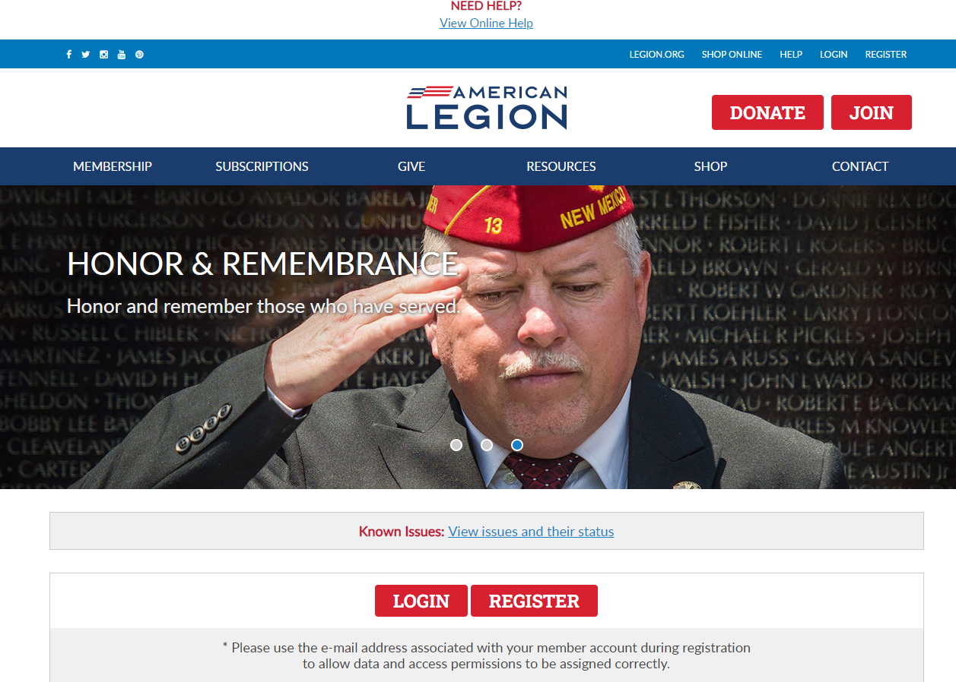
www.mylegion.org
Notes:
In the upper right, click Register. Notice, there may be additional places to access the same tool.

Slide 8
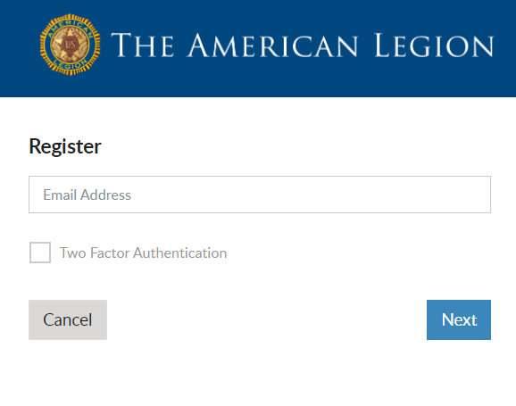
Register a MyLegion Account
STEP 1: ENTER EMAIL ADDRESS
Enter the email address on your membership record.
No Email? Cancel
Create an email, contact leadership to update and return to register.
Notes:
The first step is to enter an email address. An email is required.
<1> If you do not have an email address do not proceed. Click cancel. Create an email and contact your post adjutant, department headquarters or national customer service prior to registering an account. Registering an account with an email not set as primary on your membership record, will not provide membership details.

Slide 9
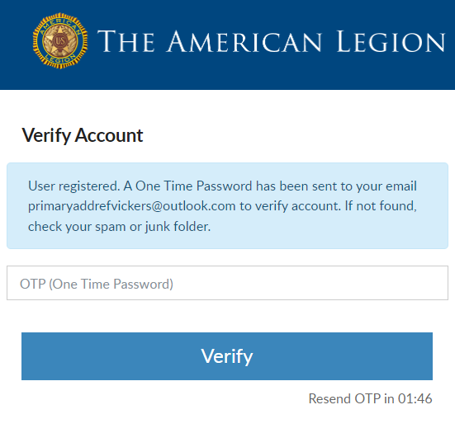
STEP 2: VERIFY ACCOUNT
Do not close this window. Go to email and retrieve One Time Password.
2-minute limit to enter OTP.
Notes:
The next step is to verify you have access to the email address.
<1> Do not close this window. Return to your email to retrieve a one time password. This message comes from The American Legion Identify Provider. Check your Spam or Junk folders if you do not see the message within 10-15 seconds. The email will be sent immediately. <2> There is a 2-minute time period to enter the one-time password and verify. This step ensures that you have access to the email address associated with this account.

Slide 10
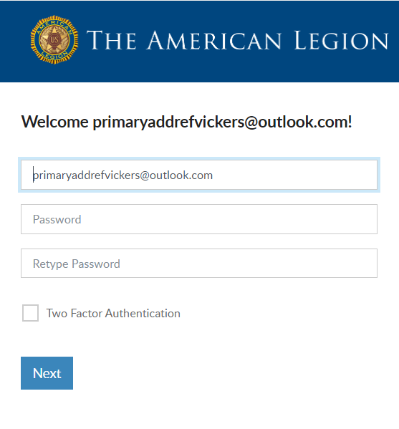
STEP 3: CREATE PASSWORD
Password Requirements:
Uppercase Letter
Lowercase Letter
Number
Symbol (!@#$%^&*)
8-character Minimum
Two Factor Authentication
​
Requires identity verification code sent via Email​
Notes:
Members will receive a welcome window to complete the final step, create a password.
The username defaults to the email address entered. It is recommended to leave the email address as your username. However, you can update the username in this window by updating it in the Username field. When creating a username, try to use something unique.
Create the password by entering it 2 times. Password requirements include <1> 1 Uppercase letter, 1 Lowercase letter, 1 number and 1 symbol with an 8-character minimum.
<2> Two-factor authentication is an extra layer of security to ensure that you're the only person who can access your account, even if someone knows your password. This extra security measure requires you to verify your identity using a randomized code we’ll email you each time you attempt to log in. Applying this feature is available when you first create your account. It can be added or removed later through your account.
Click “Next” to proceed to your account.

Slide 11
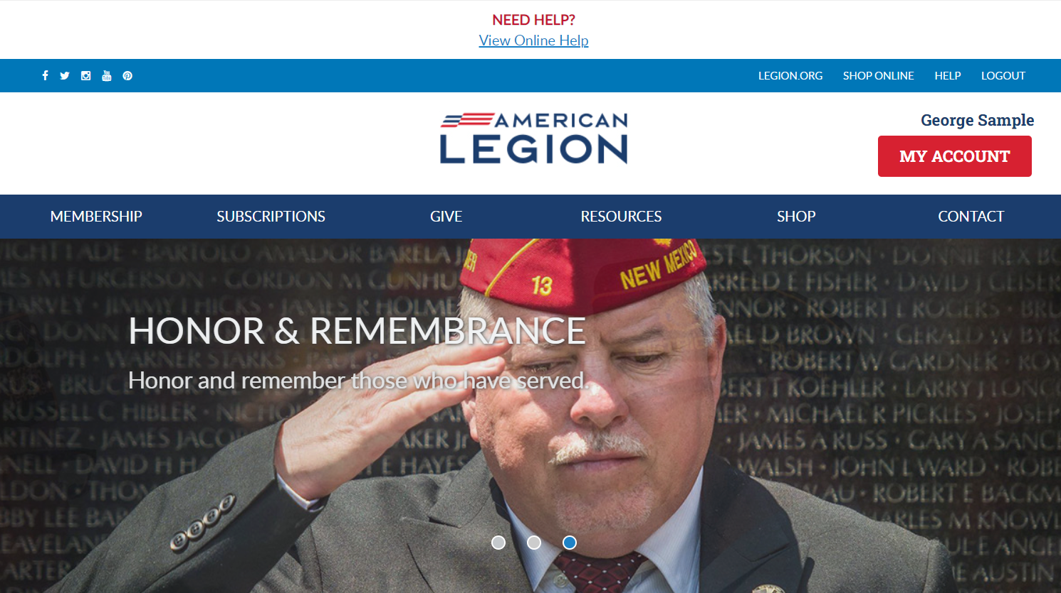
MYLEGION HOME
Notes:
Most browsers will ask if you want to save the password. Only save if your device is secure.
MyLegion Home page identifies the member’s name located above the MY ACCOUNT button.
<1> It provides links to Legion.org links. Membership include: Join, Renew and Paid Up for Life information. along with Frequently asked questions about membership eligibility. Subscriptions has online E-Newsletter options, Dispatch and Magazine subscription details. The Give menu provides multiple giving opportunities. Resources helps you find a post or service officer with User Help documentation. Shop takes you to National Emblem Sales, and Contact directs you to your National HQ directory.
Click My Account to view and manage information on file for your membership record, at national headquarters.

Slide 12
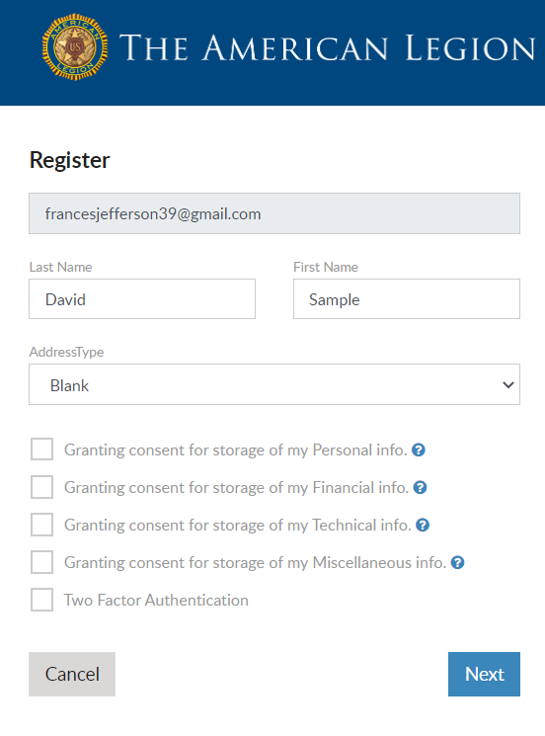
CAUTION!
If you are a member of The American Legion or Sons of the American Legion and receive this registration window, click Cancel.
Did you enter your email address correctly?
Update Email address on your membership record.
Non-members can proceed with registration.
primaryemail@gmail.com
Notes:
CAUTION! Members of The American Legion and Sons of the American Legion should not proceed if this windows appear. Continuing will not connect to your membership details. The email address entered, must match what is on file at national headquarters. Members should <1> Double check how you entered your email address. Was it entered correctly. If not, cancel and try again. <2> If it is entered correctly, click Cancel and contact your local post adjutant, department headquarters or national customer service to update your primary email address.
Non-members can continue with registration.

Slide 13
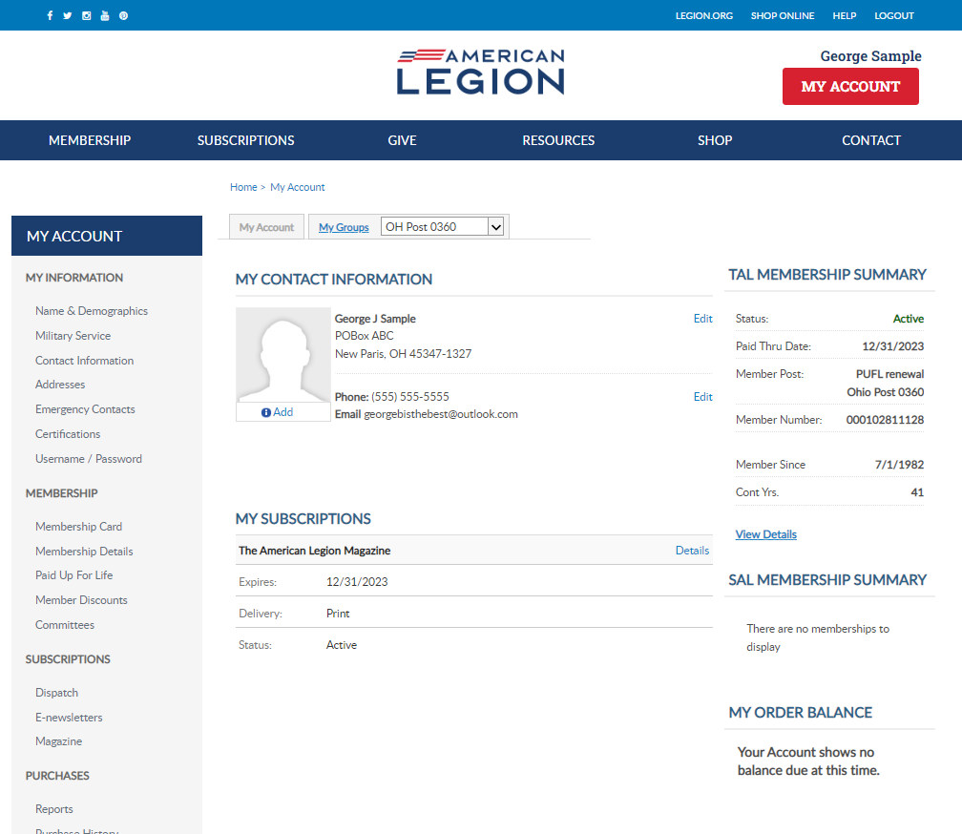
Notes:
My Account provide membership details and other online tools. Learn more about managing your account using online help resources. While logged into MyLegion, update account login credentials by going to Username/Password. This link opens a self-service window that shows your current username and main email associated with your account.
Adjutants and Commanders will have an additional My Groups menu.

Slide 14
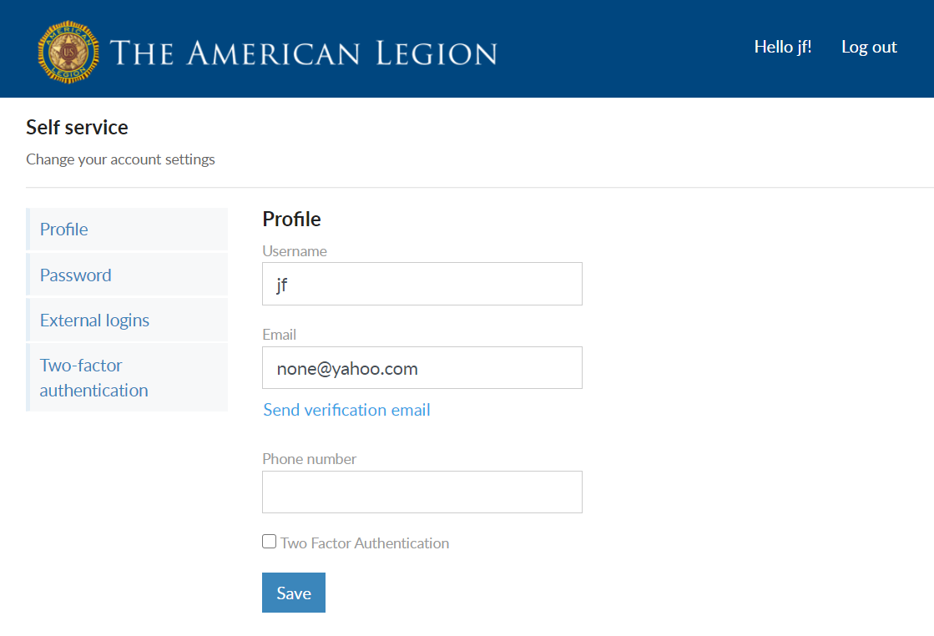
Manage Your Account
Update Username
GSample
Primaryaddrefvickers@outlook.com
Primaryaddrefvickers@outlook.com
Notes:
The email address listed in the self-service window is the main email on record and updates your primary contact information. Updating the email in Username/Password will direct all future forgot username and passwords to this email.
UserNames other than your email address should be unique, do not use common usernames. After making the updates click “Save”​. <1>

Slide 15
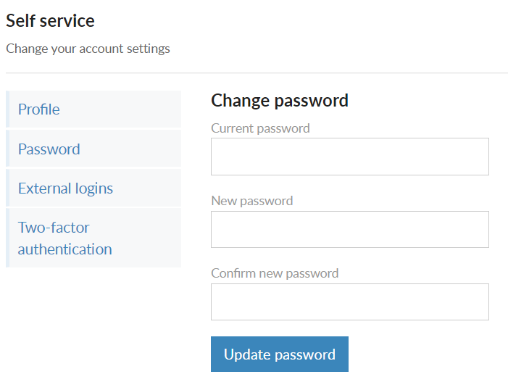
Manage Your Account
Update Password
Notes:
Updated passwords within your account require knowledge of the current password. Enter current password, create new and click “Update Password”

Slide 16
Forgot Username or Password
Notes:
The login page offers links for forgotten usernames or passwords. Selecting either of the options will send a link to the registered email.
To update the password, the username is required. If you have forgotten both, begin with forgot username.
Requesting a one-time password also sends an email with a onetime password to log into your account.

Slide 17
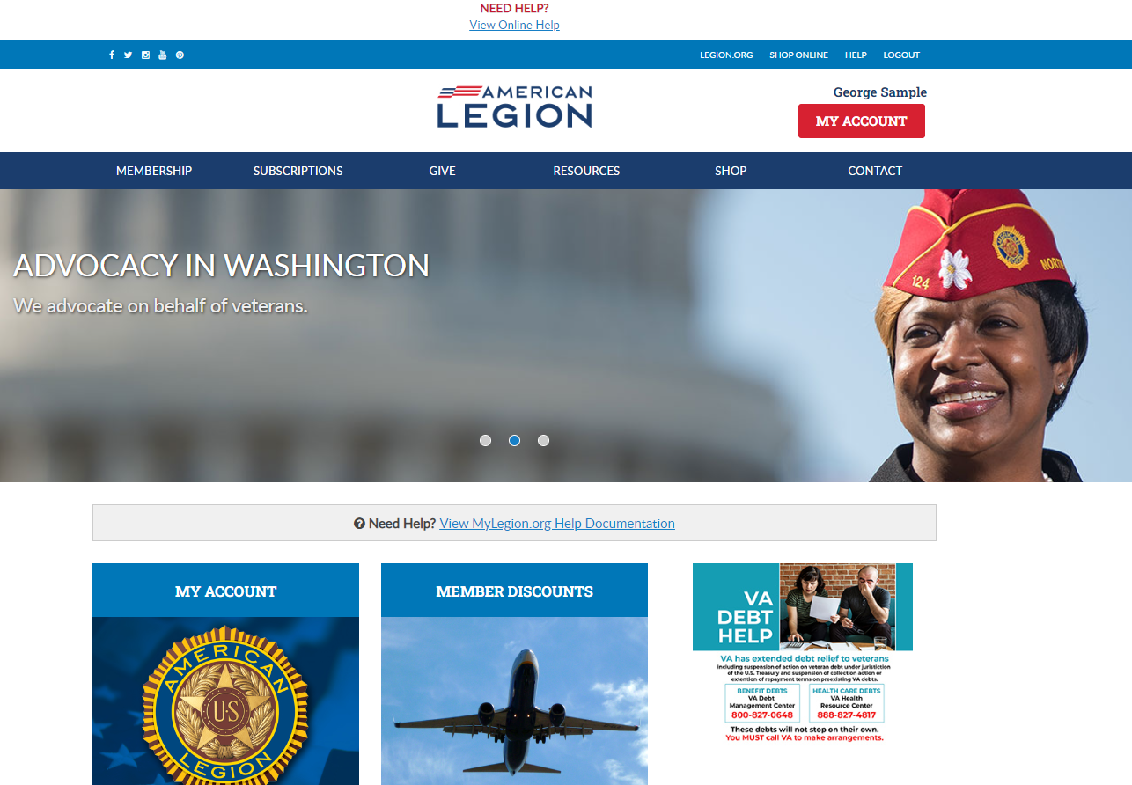
Notes:
Online help is available in MyLegion to assist with the registration process and other MyLegion topics. Help links are available throughout the page. You can also access help documentation through Resources.

Slide 18
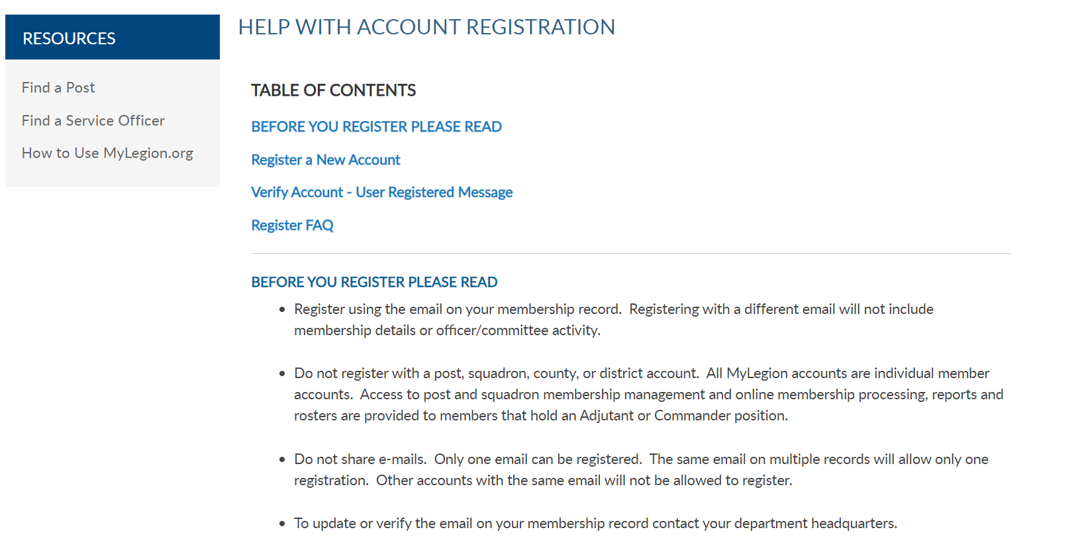
Registration – Online Help
Notes:
It includes instructions to read prior to registering, pointing out the importance of registering with the email on your membership record.

Slide 19
Leadership
Why do I have to register with my own email address if I only want to use MyLegion for leadership responsibilities?
Enhanced Security
Notes:
Members with leadership roles will register with their individual email.
Why do you have to register as an individual if all you are seeking are leadership tools such as online membership processing, access to rosters, reports, and membership management.
<1> Registering individual accounts provides enhanced security. The previous version of MyLegion only provided one account for administrative duties. If others needed access, log in credentials were shared. Now that access to leadership tools is through individual accounts, those needing access can be assigned by an administrative officer.

Slide 20
Manage My Contact Information
Notes:
Let’s take a look at your MyLegion account and review contact information.

Slide 21
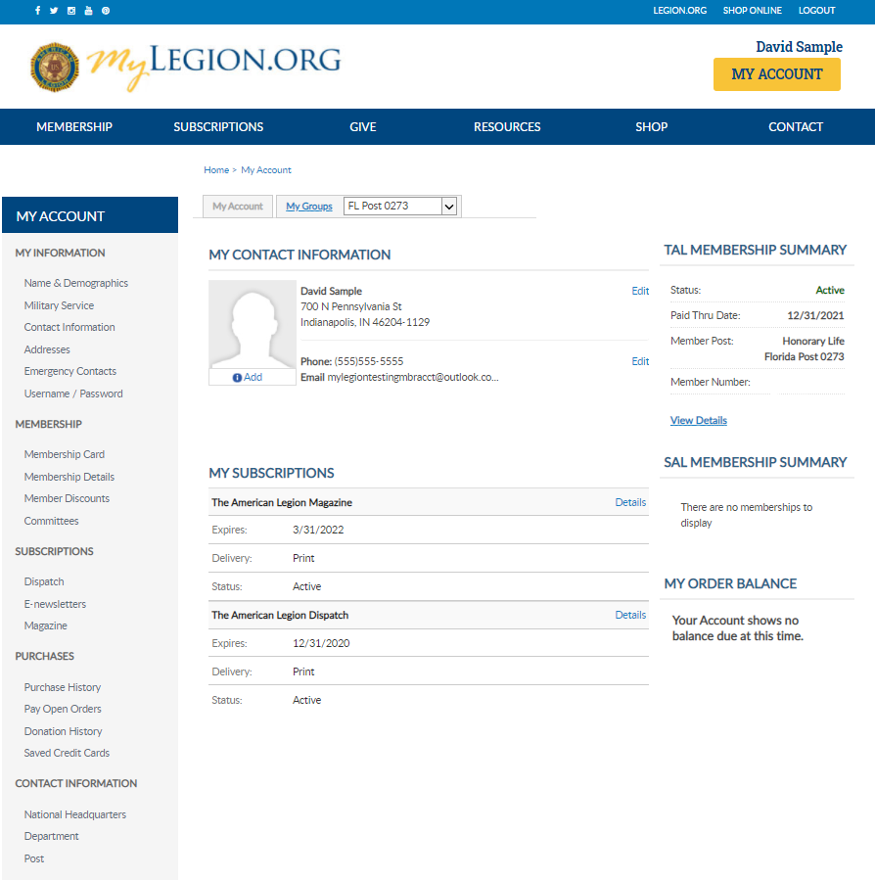
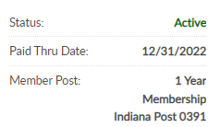
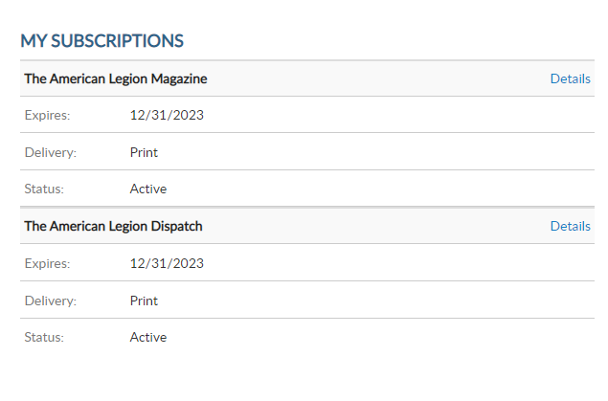
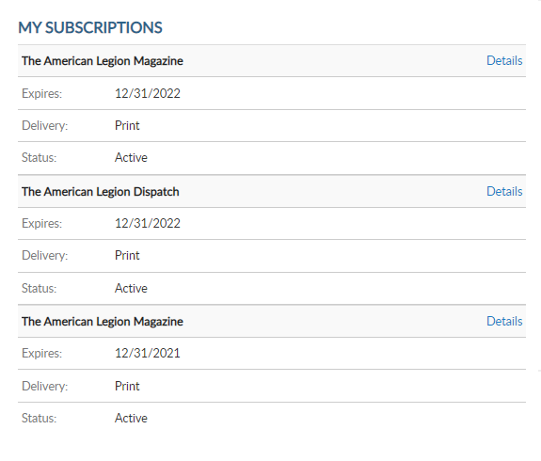
Manage Your Account
123456789
123456789
Notes:
My Contact information displays the main address, phone and email on record and is used as the primary contact for membership subscriptions, renewal notices, and all correspondence.
A new feature allows an image upload that displays on your profile. The photo uploaded can be seen by leadership groups: Post, Squadron, County, District, Department, Detachment and National staff.
To add a photo to your account, click the “Add” link on the image box in MY CONTACT INFORMATION.

Slide 22
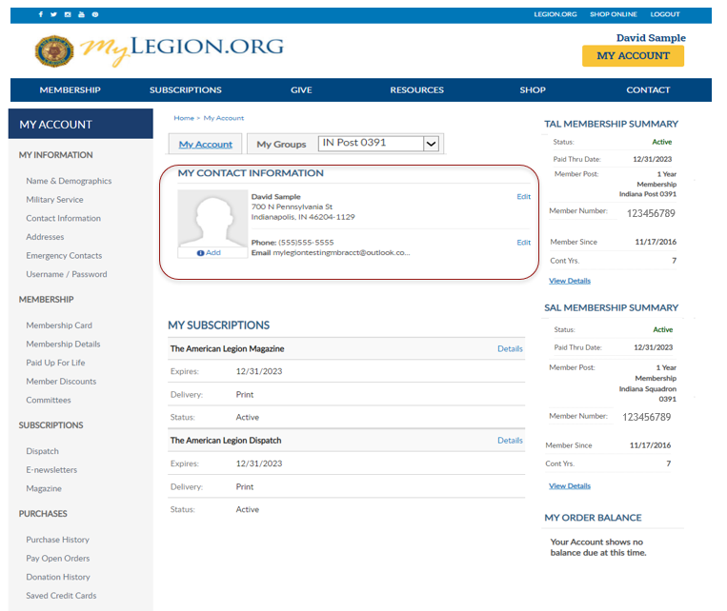
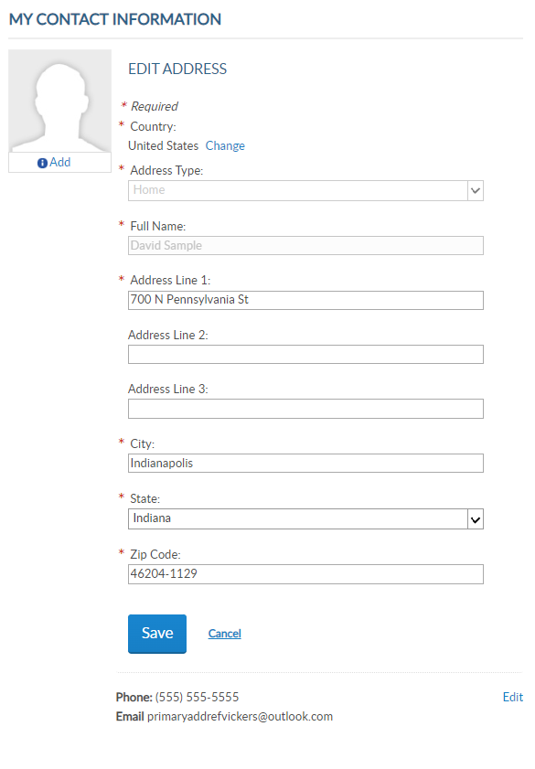
Manage Your Account
Notes:
To update your main address, click Edit in MY CONTACT INFORMATION. Enter new address and “Save”.

Slide 23
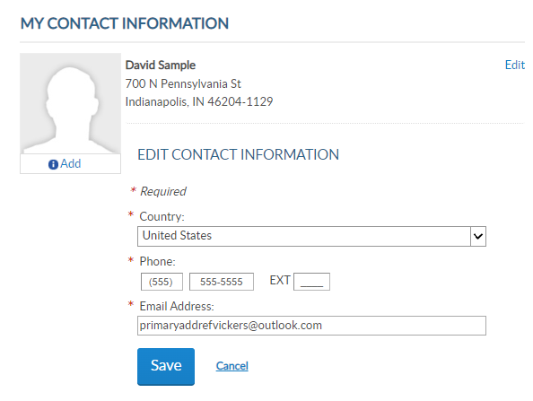
Manage Your Account
Notes:
Phone number and Email can also be updated in MY CONTACT INFORMATION.
Information in this area is listed on membership rosters, reports, and used for correspondence to you as a member. Updating the main email address also updates you’re the email associated with your MyLegion account.

Slide 24
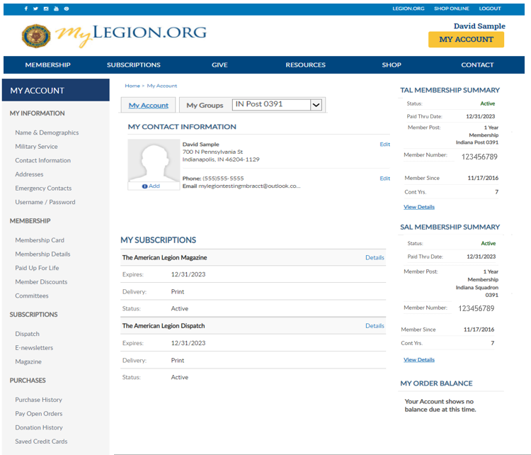
Manage Your Account
Notes:
Contact information can also be updated using the left menu items in Addresses and Contact Information. To learn more about your account, online help is located in Resources.

Slide 25
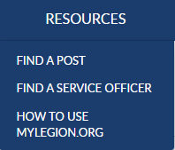
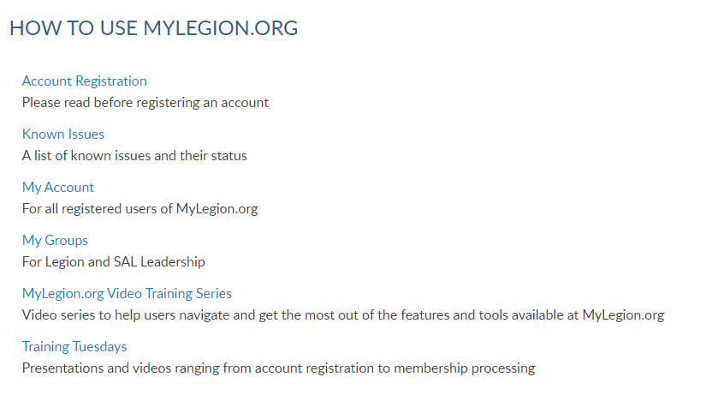
Notes:
<1> Step by step instructions for both member management and officer tools are located in this area.

Slide 26
Email:
mylegion@legion.org
Phone:
800.433.3318
Notes:
Your National support staff is available Monday through Friday, 8-4:30pm Eastern.
November Updates:
Updated screenshots reflecting last paid year 2023.

